Slide 1

Customer Spend Insights for Marketing Campaign
Presented by
Pritha Banerjee

Slide 2
Business Scenario and Objectives
Leadership and Marketing team at global retail company want to review Customer spends
Understand Customer value and ordering behaviour
Plan Marketing Campaign to drive growth
Business Scenario
Identify high-value customers
Analyze Customer ordering patterns
Segment Customers to map marketing campaigns
Business Need
Perform data analysis on spending behaviour of Customers
Generate insights that will guide design of marketing campaigns
My Role
Utilize RFM (Recency, Frequency, Monetary) analysis
Assign RFM segments to Customers
Generate insights on high-spending Customers
Identify potential churn Customers
Method

Slide 3
PART 1

Slide 4
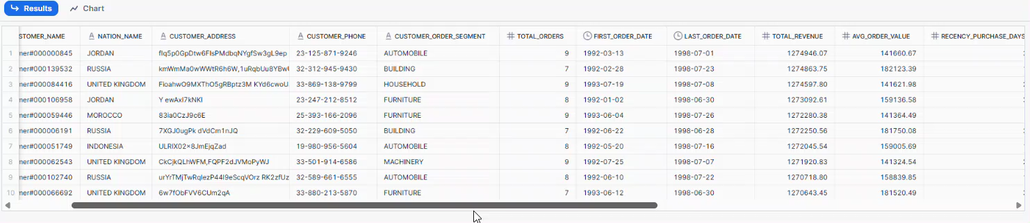
Customer Segmentation (RFM)
Business Objective
Identify customer value and ordering behavior to support targeted marketing strategies by identifying high-value customers, understanding purchase patterns, and segmenting customers effectively.
Analysis Method
Performed RFM analysis (Recency, Frequency, Monetary) using snowflake_sample_data.tpch_sf1
Calculated key metrics: last order date, total revenue, order count, average order value
Assigned RFM scores and segments to each customer
Produced a final dataset with one row per customer, sorted by business relevance

Slide 5
RFM Segmentation
RFM Group | RFM Score Logic | Description
Champions | Recency ≥ 4, Frequency ≥ 4, Monetary ≥ 4 | Recent, frequent, and high-spending customers — your most valuable segment.
Recent High Value | Recency ≥ 4, Frequency 2–3, Monetary ≥ 4 | New or moderately frequent customers with high spend.
New Big Value | Recency ≥ 4, Frequency ≤ 1, Monetary ≥ 4 | Very recent, infrequent buyers who spent a lot.
Frequent High Value | Recency 2–3, Frequency ≥ 4, Monetary ≥ 4 | Older but still frequent and high-value customers.
Infrequent High Value | Recency ≤ 2, Frequency ≤ 2, Monetary ≥ 4 | Previously valuable customers who are now inactive.
Loyal Value | Recency ≥ 4, Frequency ≥ 4, Monetary 2–3 | Active and loyal customers with moderate spend.
Loyal but Low Value | Recency ≥ 4, Frequency ≥ 4, Monetary = 1 | Loyal and frequent buyers with low transaction value.
Recent Mid Value | Recency ≥ 4, Frequency 2–3, Monetary ≤ 2 | Recent buyers with moderate frequency and low spend.
New Low Value | Recency ≥ 4, Frequency ≤ 1, Monetary ≤ 2 | New customers with low frequency and low spend.
Frequent but Low Value | Recency 2–3, Frequency ≥ 4, Monetary ≤ 2 | Frequent buyers who spend little and haven’t bought recently.
Inactive Low Value | Recency ≤ 2, Frequency ≤ 2, Monetary ≤ 2 | Inactive Low Value customers are disengaged buyers with low spend, rare purchases, and minimal impact

Slide 6
PART 2

Slide 7
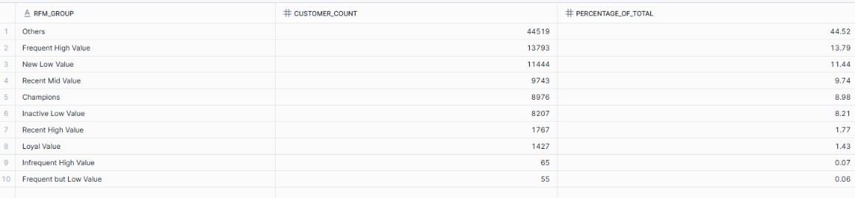
Customer count in each segment - Result
Business Objective
Identify customer count of each segment to uncover actionable insights for marketing strategy.
Analysis Method
Queried the final RFM segmentation to count how many customers belong to each segment
Identified distribution of customer types (e.g., loyal, at-risk, high-value) to guide targeted campaigns

Slide 8
Customers count in each segment - Analysis
RFM GROUP | Recommendation
Champions, Frequent High Value, Loyal Value, Recent High Value (23.62%) | High-value customers to prioritize for retention and upselling.
Recent Mid Value, New Big Value, Loyal Low Value, Infrequent High Value (9.8%) | Recent and loyal Customers with potential for growth
New Low Value, Frequent But Low Value, Inactive Low Value (22.62%) | Drive stronger engagement strategy for value growth
Others (44.52%) | Largest group with unclear behavior; needs further classification or re-engagement.

Slide 9
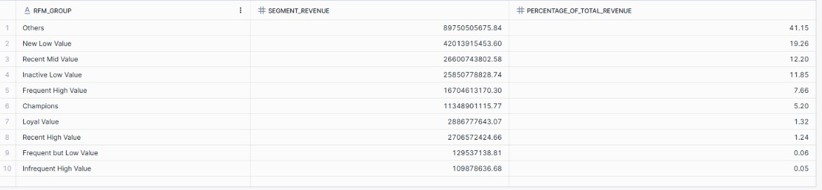
Total revenue generated by each segment - Result
Business Objective
Evaluate the financial contribution of each customer segment to prioritize marketing investments.
Analysis Method
Aggregated total revenue per RFM segment using SQL
Identified which segments drive the highest revenue to focus on retention and upselling strategies

Slide 10
Total revenue generated by each segment - Analysis
Segment Group | Behaviour Insight | Revenue Contribution | Recommended Strategy
Others, New Low Value | High revenue | 60.41% combined | Reassess and convert through targeted engagement
Mid-Value Segments (Loyal Value, Recent Mid Value) | Moderate engagement, strong revenue | 17.40% combined | Nurture with growth-focused campaigns
High Value (Frequent High Value, Champions, Recent High Value, Infrequent High Value, New Big Value, Loyal But Low Value, Frequent But Low Value) | High loyalty, low revenue share | 10.34% combined | Strengthen monetization via bundling and offers
Inactive Low Value | Low activity, notable revenue | 11.85% | Prioritize retention with reactivation efforts

Slide 11
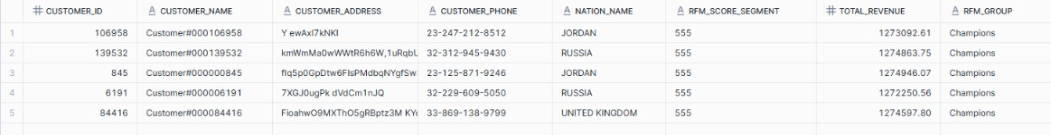
Top 5 High Value customers by the RFM score- Result & Recommendation
Business Objective
Pinpoint the most valuable customers to inform premium engagement and loyalty strategies.
Analysis Method
Ranked all customers by their RFM score
Identified the top 5 high-value customers based on recency, frequency, and monetary metrics
These customers represent the strongest potential for retention and upselling
Recommendation:- These customers should be prioritized for exclusive loyalty programs, early product access, and personalized offers to maintain engagement and increase lifetime value.

Slide 12
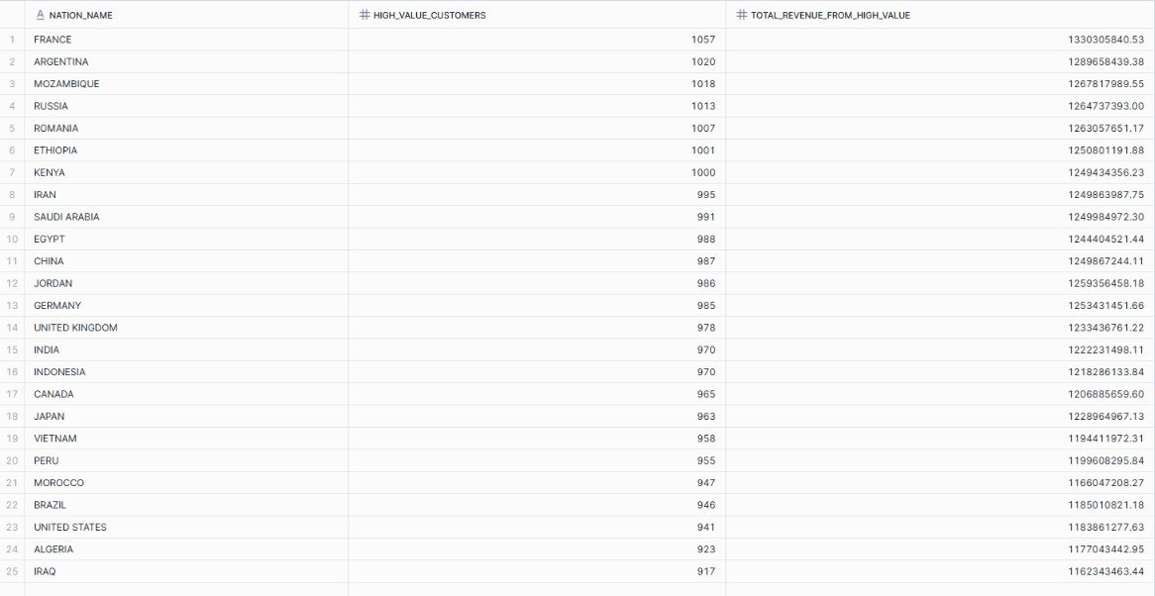
Nations have the highest number of High Value customers according RFM group- Result
Business Objective
Identify geographic distribution of top-tier customers to support region-specific marketing strategies.
Analysis Method
Filtered customers with highest RFM segments
Grouped and counted high-value customers by nation
Identified countries with the largest concentration of valuable customers for targeted outreach

Slide 13
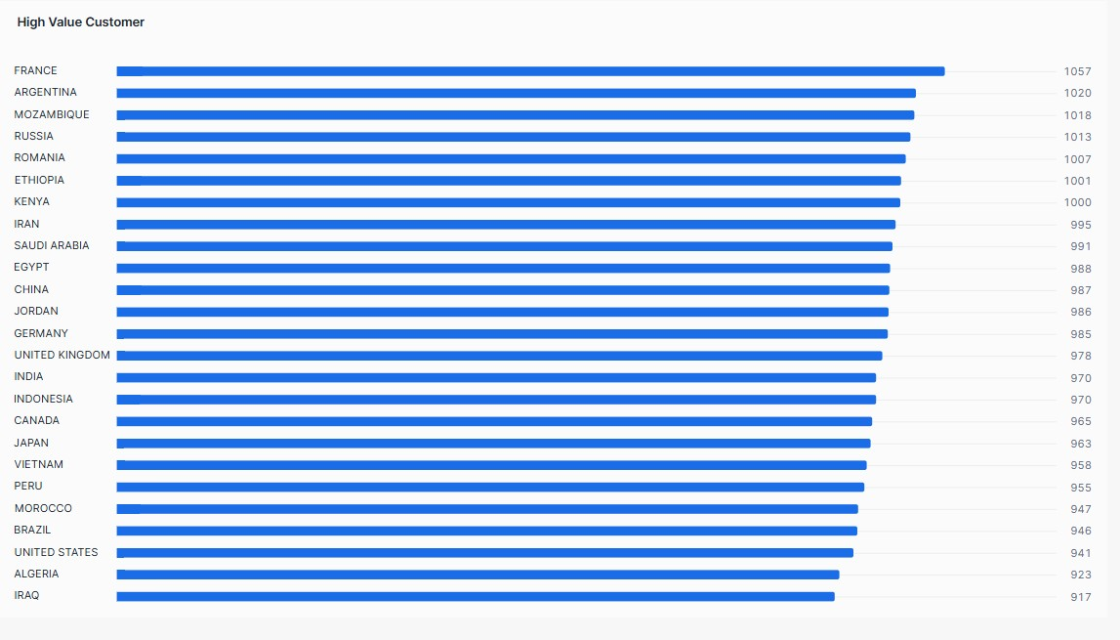
Nations have the highest number of High Value customers according RFM group- Insights
France and Argentina lead in high-value customer volume — ideal for premium campaigns and loyalty initiatives.
Emerging markets like Mozambique, Russia and Romania show strong high-value presence — potential for growth-focused investment.
Global spread includes both developed and developing nations, suggesting wide appeal and diverse engagement patterns.

Slide 14
PART 3

Slide 15
RFM Scoring and Segmentation Approach
Metric | What It Measures | Why It Matters
Recency | How recently a customer made a purchase | Recent buyers are more likely to engage again
Frequency | How often they made purchases | Frequent buyers show loyalty and interest
Monetary | How much they spent in total | High spenders contribute more to revenue
Scoring Method
NTILE() function has been used to divide a result set into equal-sized buckets or groups to assign scores from 1 to 5 for each metric. This created a 3-digit RFM score.
Metric | ORDER BY Direction | Interpretation of Score
Recency | recency_purchase_days DESC | Lower days = higher score (more recent)
Frequency | total_orders ASC | More orders = higher score
Monetary | total_revenue DESC | Higher spend = higher score

Slide 16
RFM Score Using CONCAT() & SUM()
Function to create RFM Group
CONCAT() function to combine the three RFM scores — Recency, Frequency, and Monetary — into a single 3-digit RFM score (e.g., 555). This score represents each customer’s behavioral purchase blueprint.
CONCAT(recency_score, frequency_score, monetary_score)
Example 555 = best of all three dimensions → recent, frequent, and high-spending.
Enables segmentation into meaningful groups, example:
Champions
Infrequent High Value
Used to:-
Identify top performers
Spot lapsed high spenders
Tailor marketing strategies by segment
Aggregate Function to create RFM Group
SUM() function to add the three individual RFM scores — Recency, Frequency, and Monetary (e.g., 5+5+5 = 15). This score represents each customer’s overall purchasing behavior and helps segment customer value.

Slide 17
Key RFM Driver & Segment Distribution Insights
Based on RFM segmentation analysis, Monetary Value appears to be the most significant driver of customer behavior.
Segments like “Others” and “New Low Value” contribute disproportionately high revenue despite lower engagement.
Key RFM Driver
The distribution of customers across RFM segments reveals that the company’s overall customer base is skewed toward lower engagement and spending.
Most customers fall into the "Others" segment, indicating they either purchase infrequently, or haven’t bought recently.
In contrast, high-value segments like “Champions”, “Recent High Value”, “New Big Value”, “Frequent High Value”, “Infrequent High Value” together capture around 10% in total , suggesting that while the company has a few highly profitable and loyal customers, the majority may require reactivation or nurturing strategies to increase their lifetime value.
Segment Distribution Insights

Slide 18
Strategic Recommendations
Focus more on the high-value customers with special offers or loyalty programs.
Spend less on general campaigns for low-value groups.
Create region-specific promotions for places like France and Argentina.
Use spending amount (monetary value) as the main way to find important customers, even if they don’t buy often.

Slide 19
Customer Lifetime Value (CLV) Estimation & Analysis Method
Further Analysis:-
Estimates how much revenue a customer will generate over their relationship with the company. It prioritize marketing spend, retention efforts, and product targeting.
A retained customer is one who continues to make purchases over weeks, months, or years
Retention Rate = (Customers who stayed/Customers at start) × 100
Analysis Method
recency_score | Interpretation | retention_multiplier | Meaning
5 | Very recent purchase | 1.5 | Highly likely to stay and repurchase
4 | Recent | 1.3 | Good chance of retention
3 | Moderate recency | 1.1 | Neutral retention
2 | Less recent | 0.9 | At risk of churn
1 | Long time since last purchase | 0.7 | Low retention likelihood

Slide 20
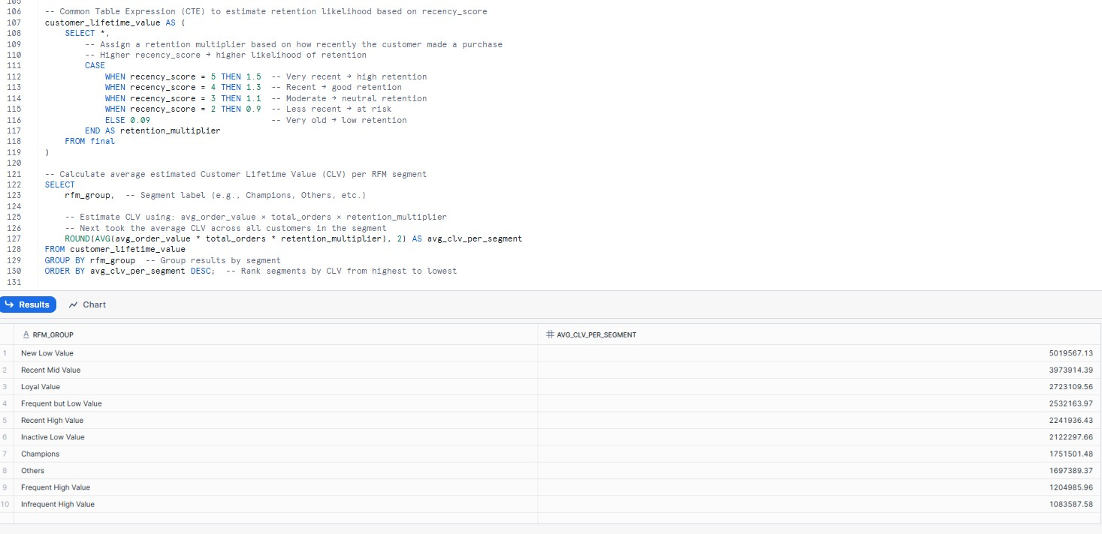
Customer Lifetime Value (CLV) Estimation- Results

Slide 21
Customer Lifetime Value (CLV) Estimation- Analysis

Slide 22
CLV-Based Recommendations
RFM Group | Behavior Insight | Recommended Strategy
New Low Value | Recently acquired, low spend | Onboard effectively and incentivize repeat buys
Recent Mid Value | Newly active with solid CLV | Nurture with personalized engagement
Loyal Value | Consistent buyers with strong CLV | Strengthen loyalty programs and upsell paths
Inactive Low Value | Low activity but moderate CLV | Reactivate with targeted offers
Frequent but Low Value | Regular buyers, low spend | Promote higher-value products
Recent High Value | Recently active with high spend and frequency | Retain with exclusive offers and personalized upsell strategies.
Others | Broad, undefined group | Segment further and test conversion tactics
Champions | Highly engaged but lower-than-expected lifetime value | Reassess monetization; offer bundles or upsells
Infrequent High Value | Previously valuable, now disengaged | Winback campaigns with tailored messaging
Frequent High Value | High frequency, low CLV | Encourage higher spend through premium incentives

Slide 23
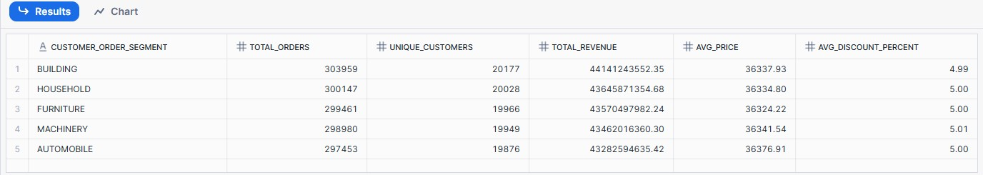
Product-level purchasing behaviour
Business Objective
Identify product-level purchasing behavior segmented by customer order segment and brand to uncover buying patterns and discount impact.
Analysis Method
Segmented results by customer type and brand
Sorted output to highlight top-performing brand-segment combinations

Slide 24
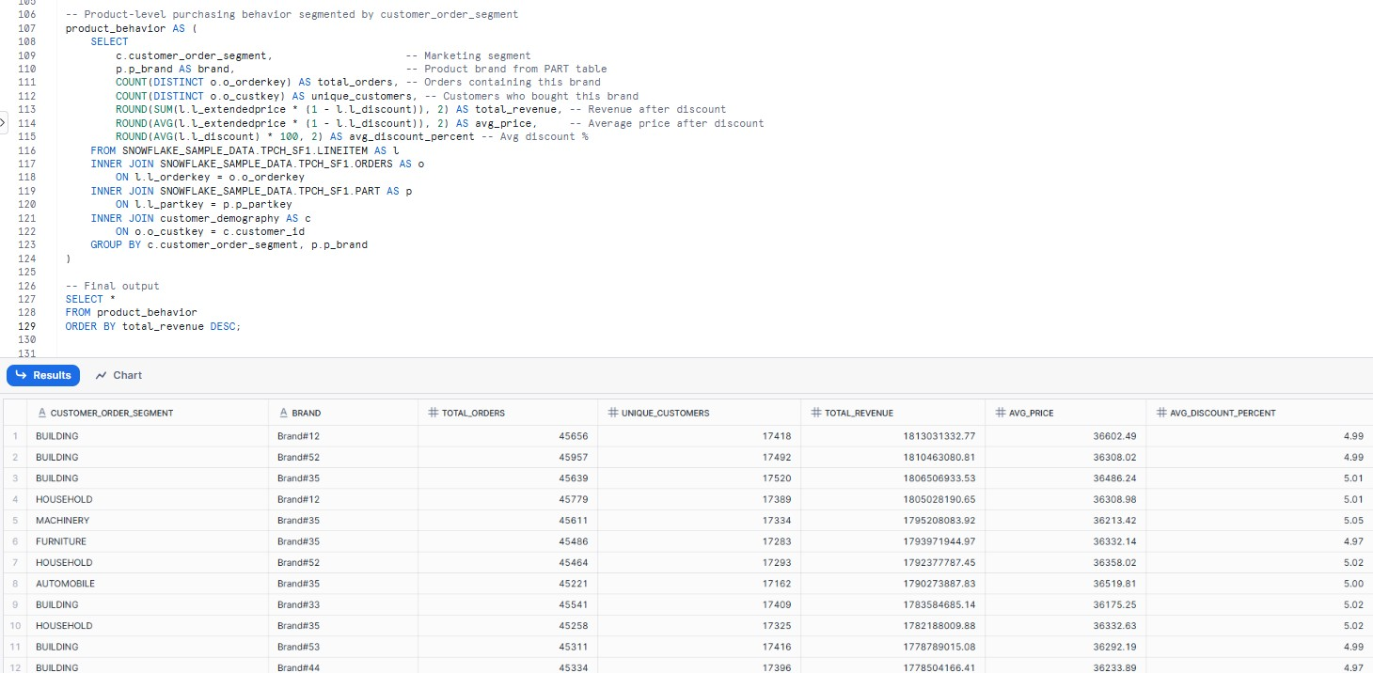
Brand-level purchasing behaviour

Slide 25
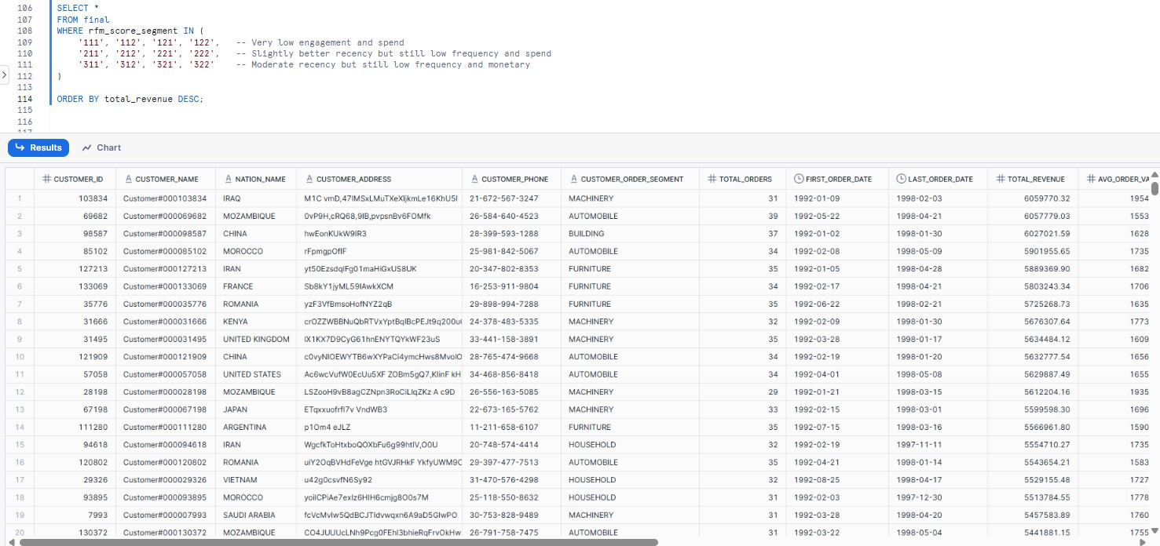
Churn Prediction Modeling
Business Objective
Identify low-engagement customer segments to support churn prediction modeling and proactive retention strategies.
Analysis Method
Calculate total orders, revenue before/after discount, and discount percentage
Segmented results by customer type and brand
Sorted output to highlight top-performing brand-segment combinations

Slide 26
Churn Prediction Modeling - Insights and Recommendation
Segment Group | Recency Codes | Behaviour Insight | Recommended Strategy
Very Low Engagement & Spend | 111, 112, 121, 122 | Customers with very low recency and spend; likely disengaged | Launch reactivation campaigns with strong incentives or personalized win-back messaging
Slightly better recency but still low frequency and monetary value | 211, 212, 221, 222 | Recently active but still low engagement and spend; potential early-stage churn risk | Send personalized reminders and low-risk offers to re-engage interest
Moderate Recency, Low frequency & Spend | 311, 312, 321, 322 | Moderate recent activity but low purchase frequency and value | Offer targeted promotions and highlight value products to encourage repeat purchases

Slide 27
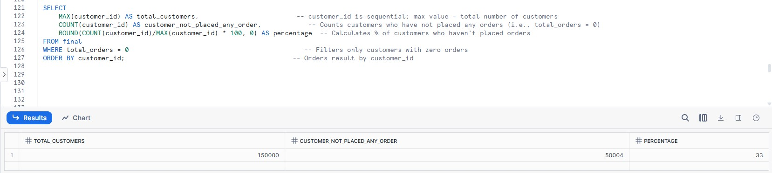
Customer not placed any orders - Result
Business Objective
Identify customers who have not placed any orders to assess engagement gaps and potential churn risk.
Analysis Method
Queried customer data to find those with zero total orders
Calculated the total number and percentage of inactive customers
Provided insight into customer onboarding effectiveness and areas for reactivation strategy

Slide 28
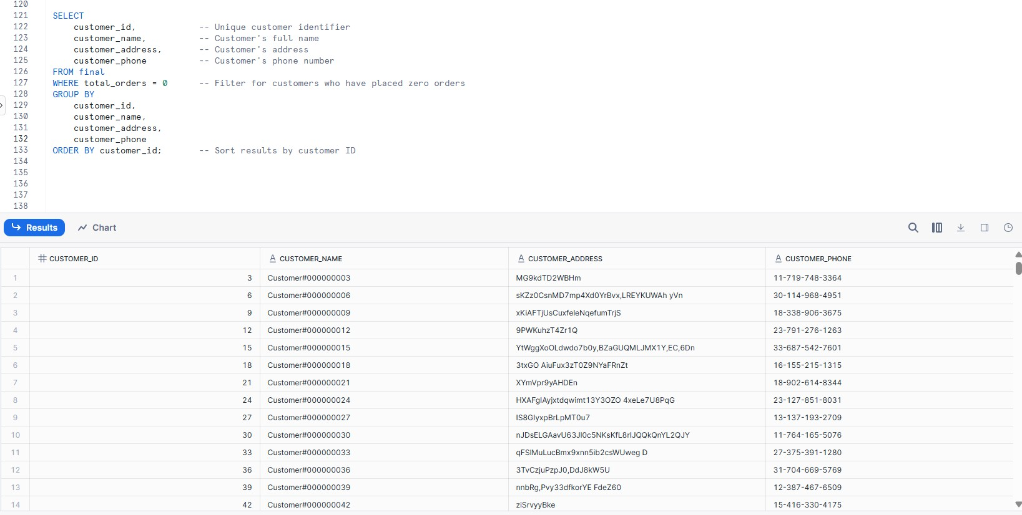
Customers List not placed any orders - Result

Slide 29
Turning Signups into Buyers: Recommendations for Inactive Customers
Focus Area | Recommended Action
Onboarding Optimization | Review the onboarding journey—are customers dropping off before checkout? Simplify sign-up, add welcome incentives.
First-Purchase Incentives | Offer exclusive discounts or free shipping for first-time buyers to reduce hesitation.
Behavioral Segmentation | Segment these users by signup date, location, or interest to tailor outreach campaigns.
Email/SMS Re-engagement | Send personalized “Still thinking about it?” messages with curated product suggestions.

Slide 30
THANK YOU

